Slide 1


Irwindale Public Library July 24, 2024

Slide 2
New Library Project Update
Project Update
Design for 13,000 sq. ft. Library
Project Site
Landscaping
Exterior Renderings
Library Floor Plan Concept
Library Interior Concepts
Next Steps

Slide 3
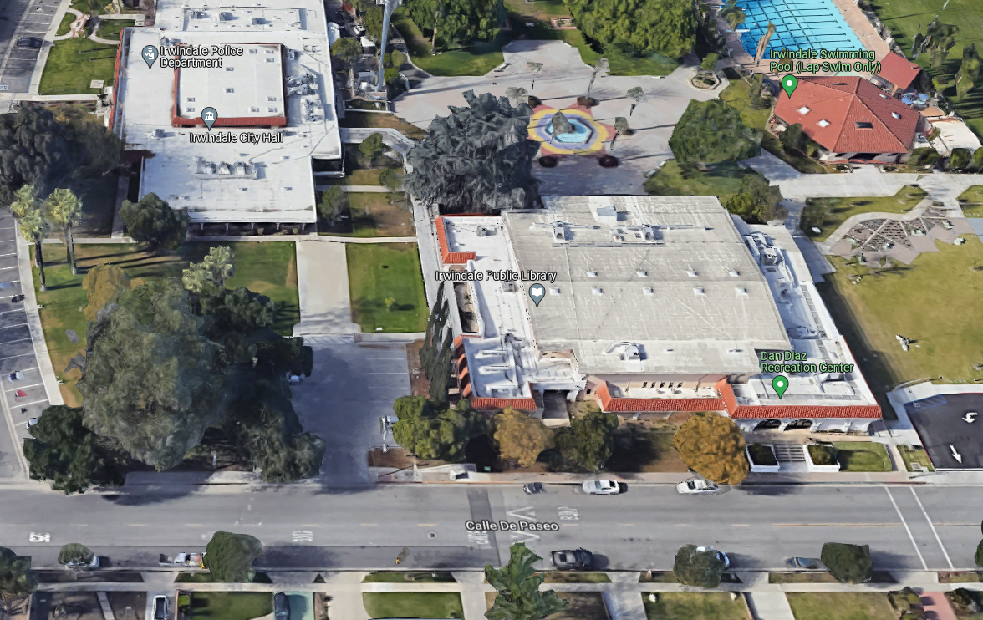
Project Site

Slide 4
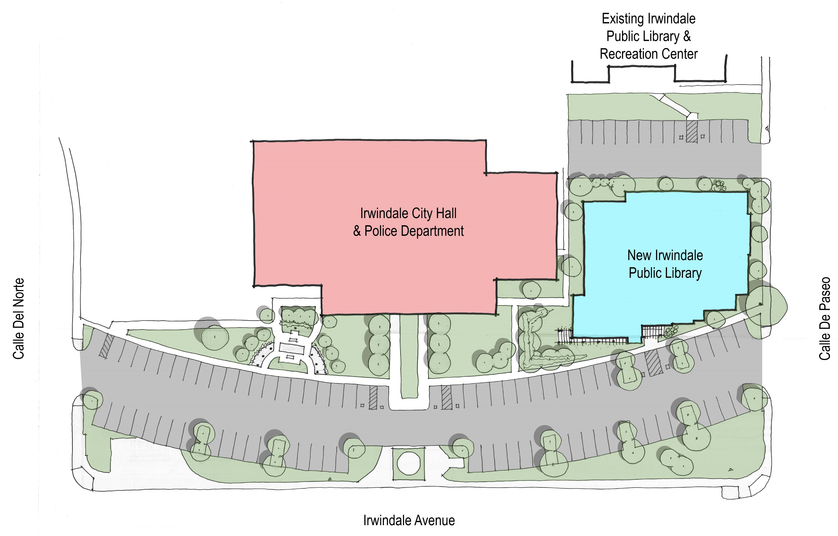

Slide 5
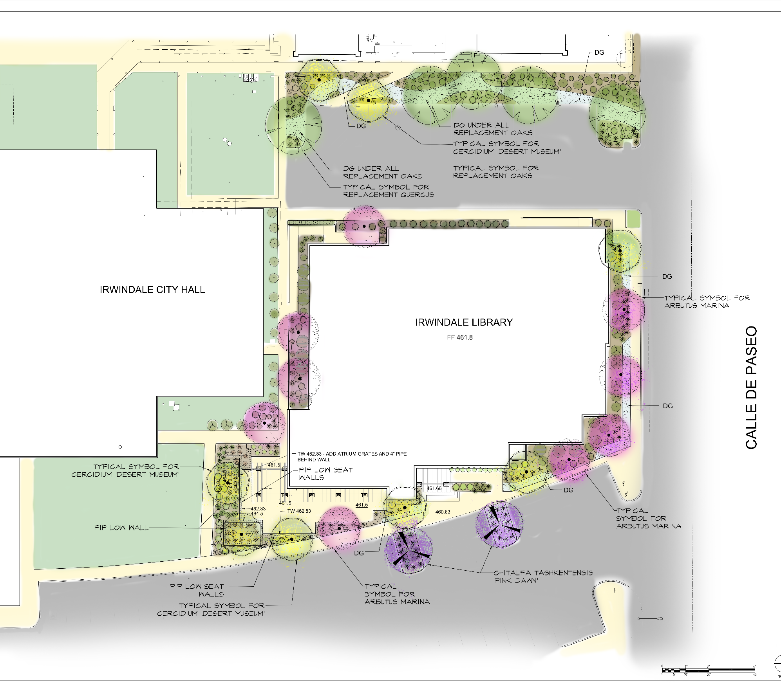
Five Replacement Oaks
LLandscape plan

Slide 6
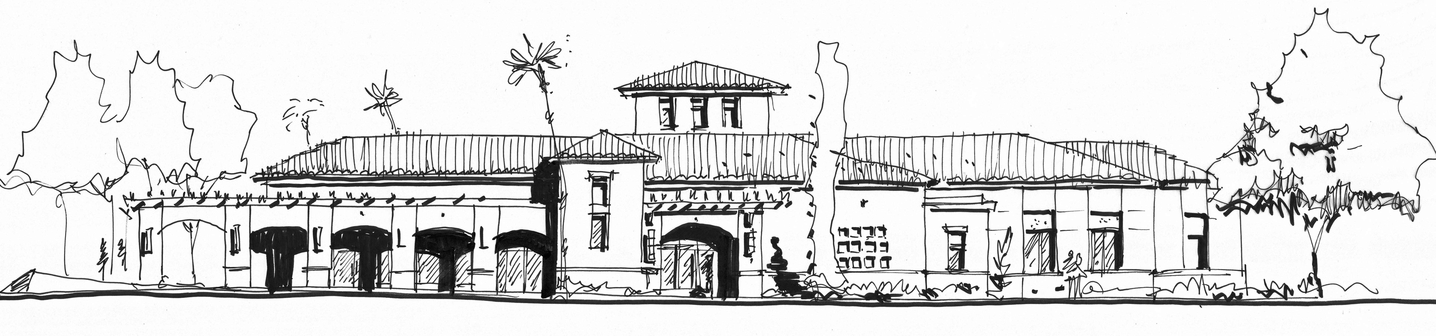



Slide 7
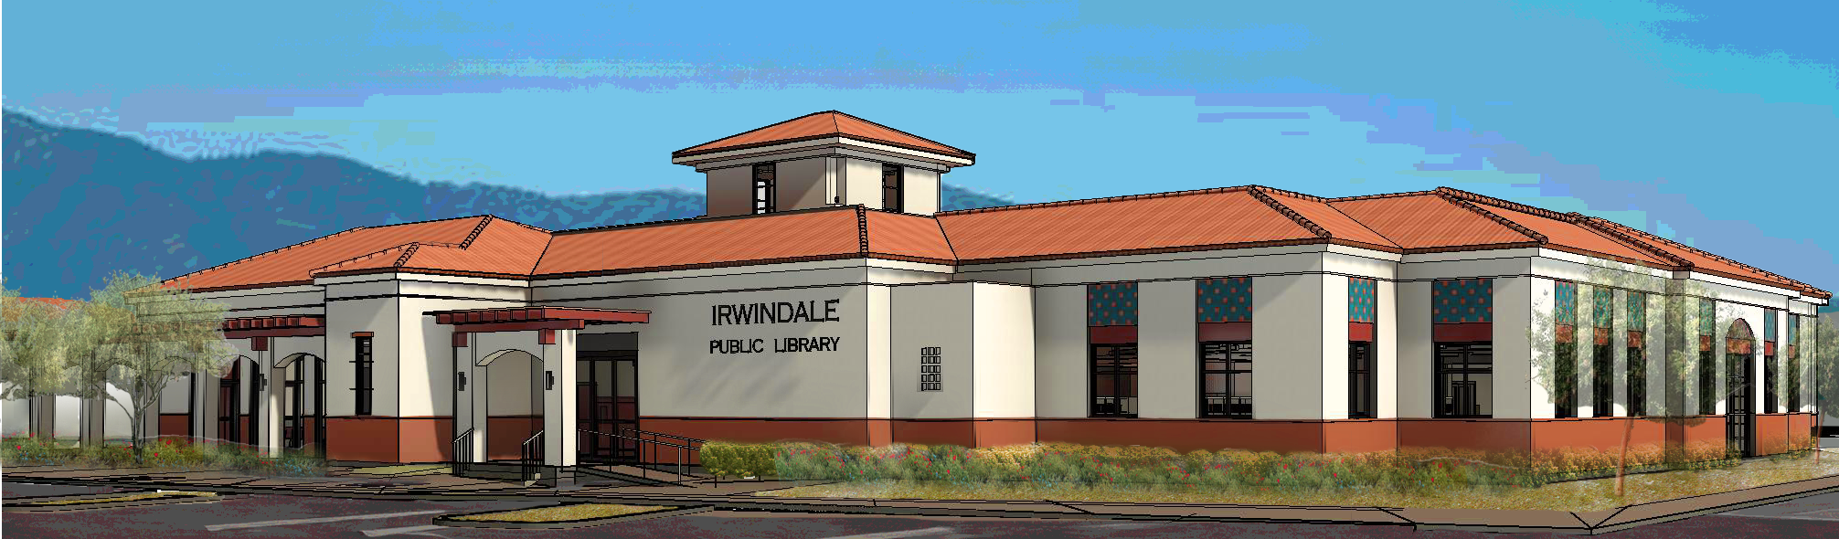
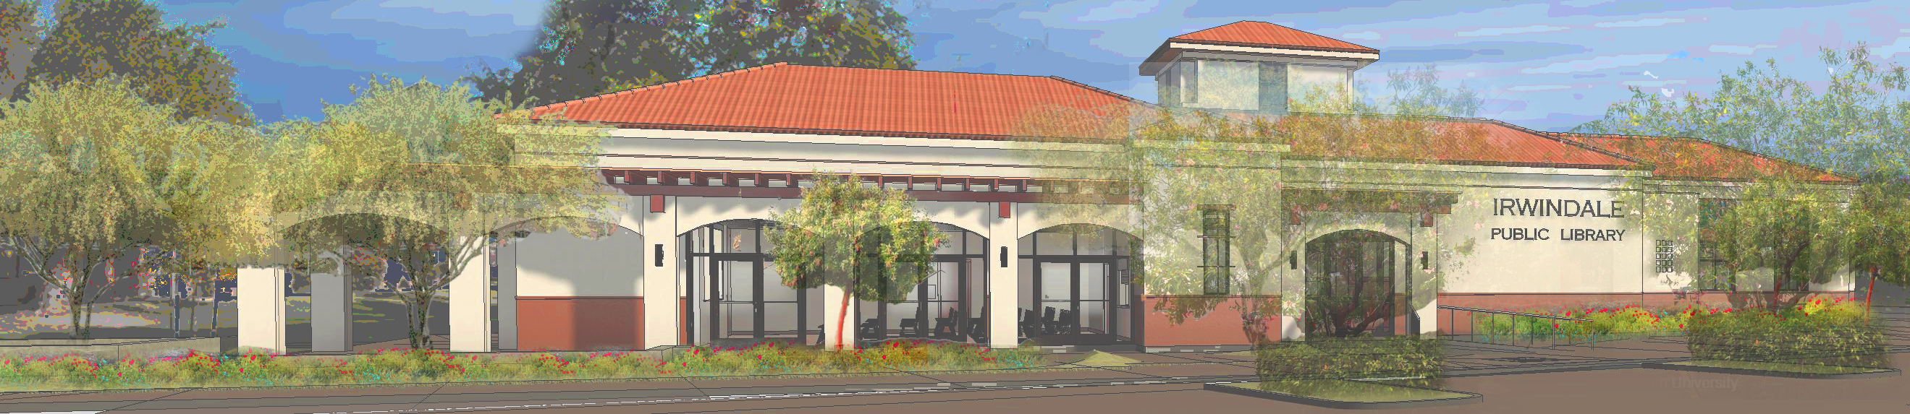

Slide 8
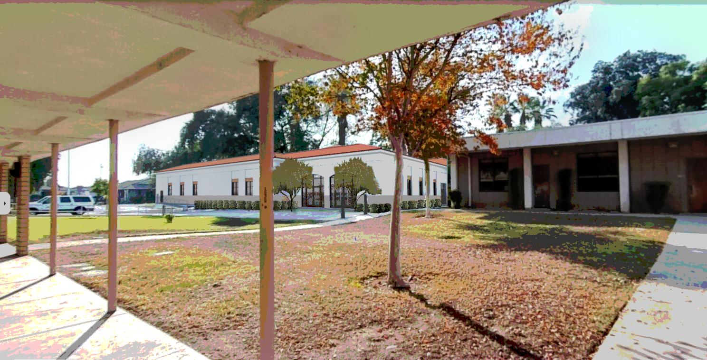

Slide 9
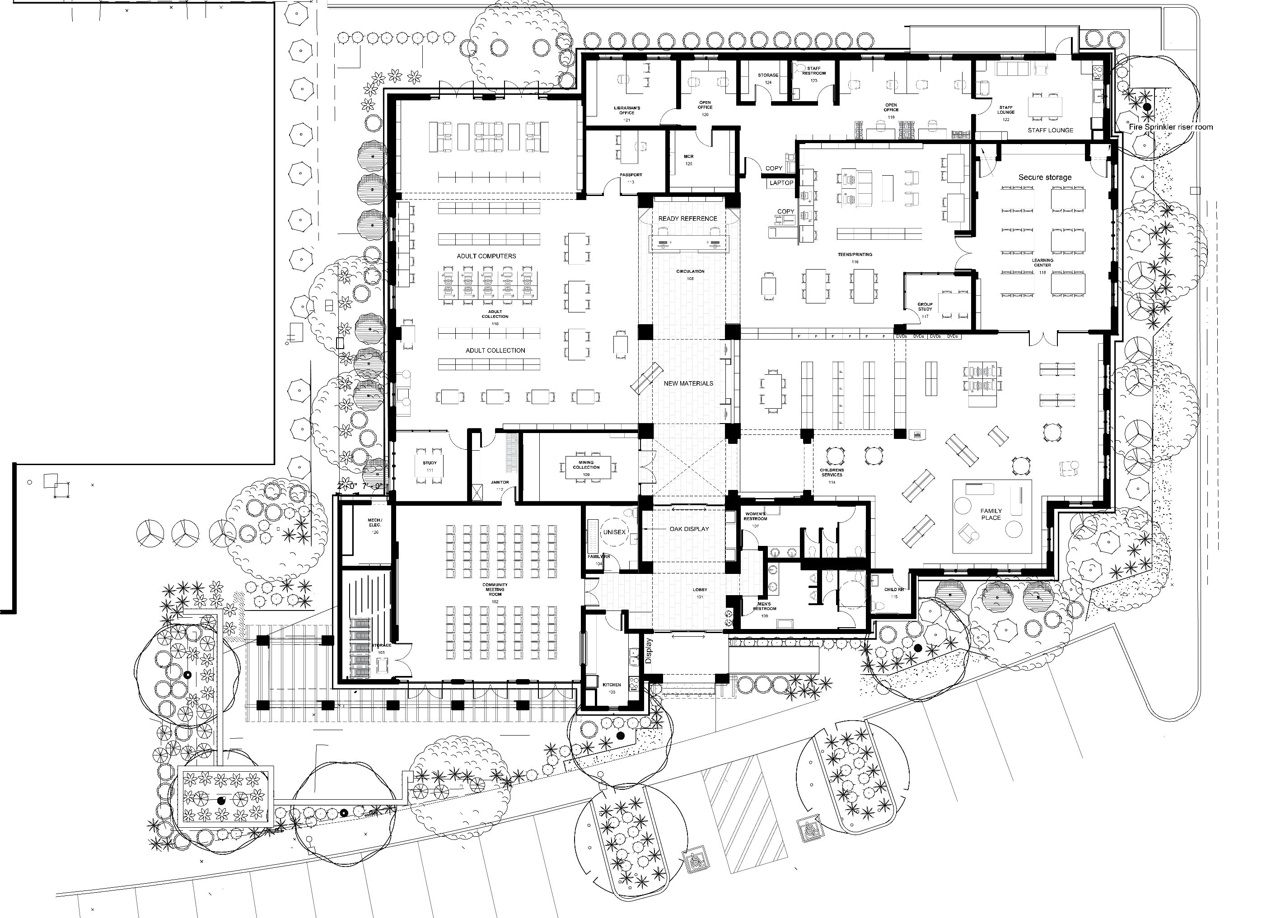
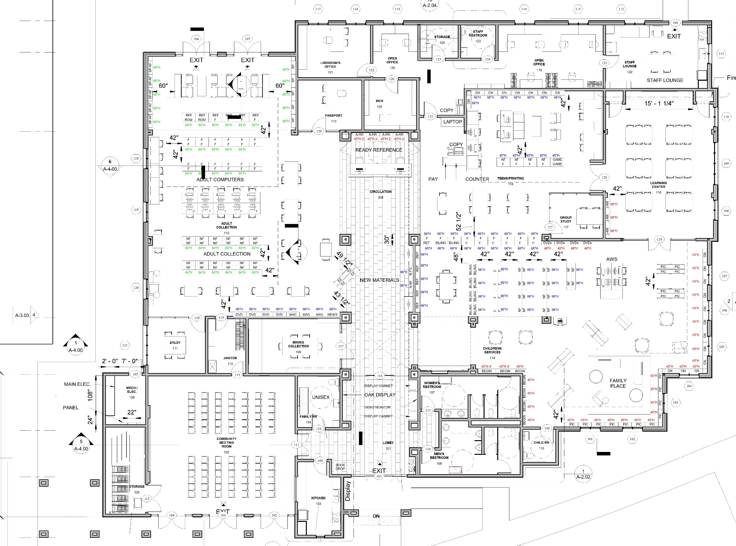

Slide 10
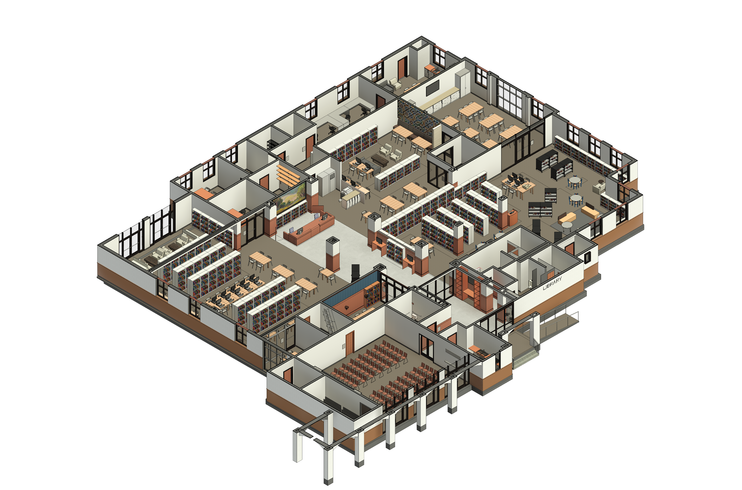

Slide 11
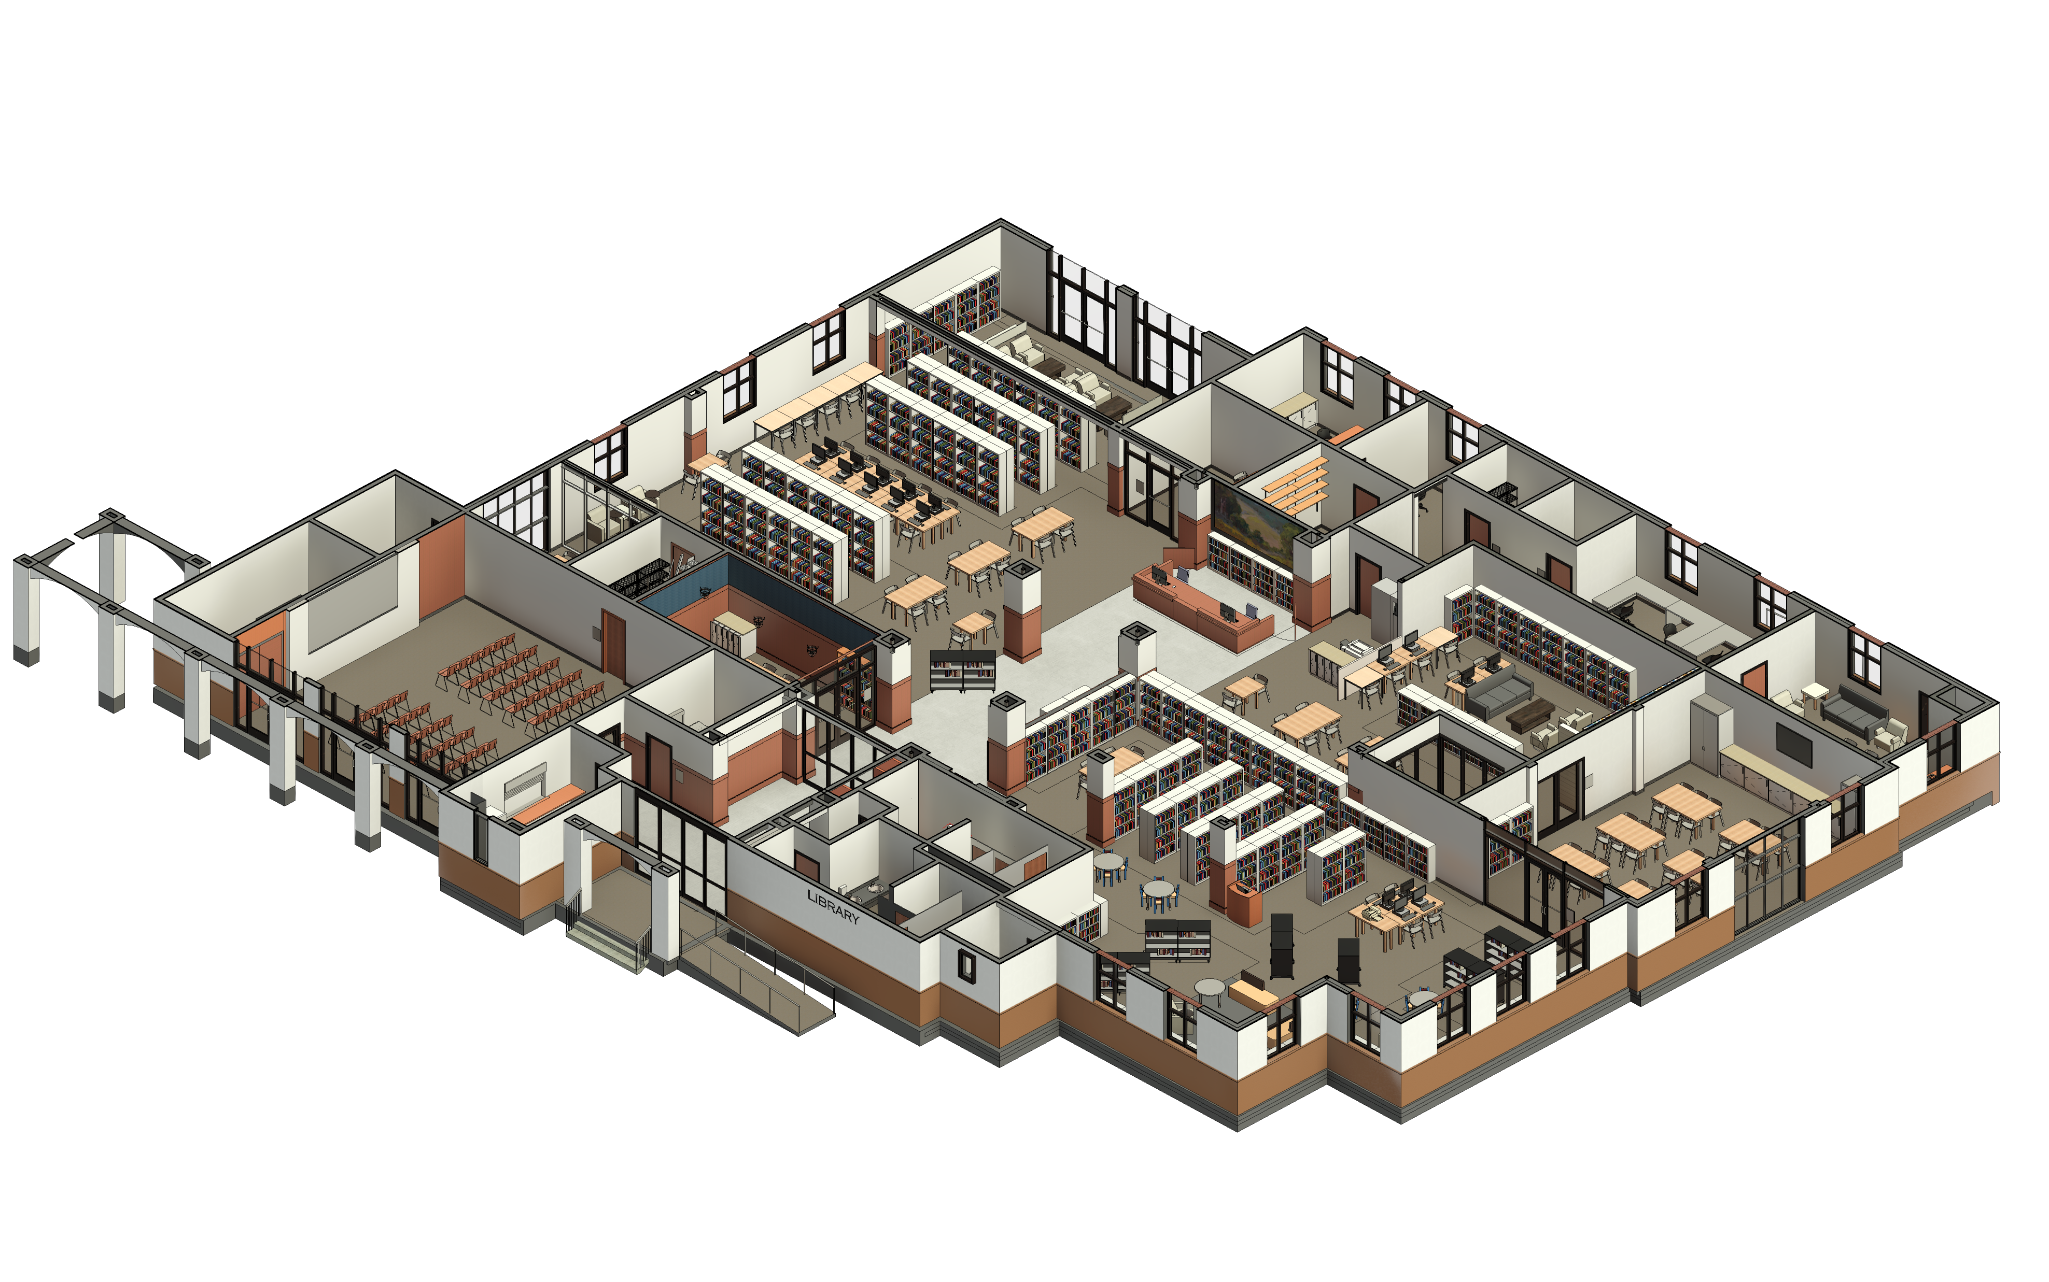

Slide 12
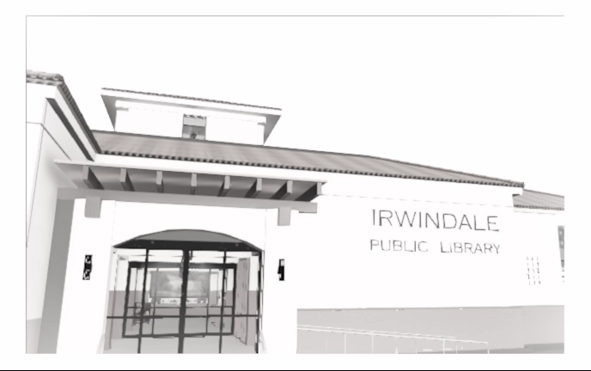

Slide 13
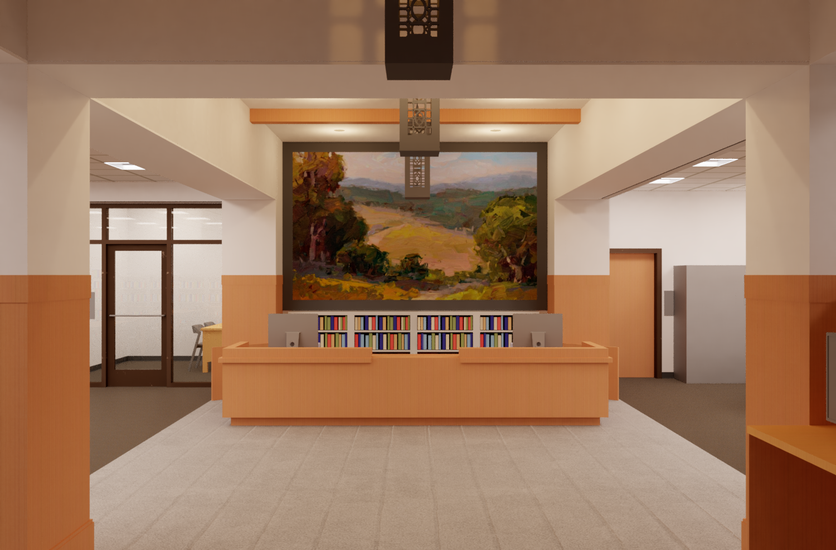

Slide 14
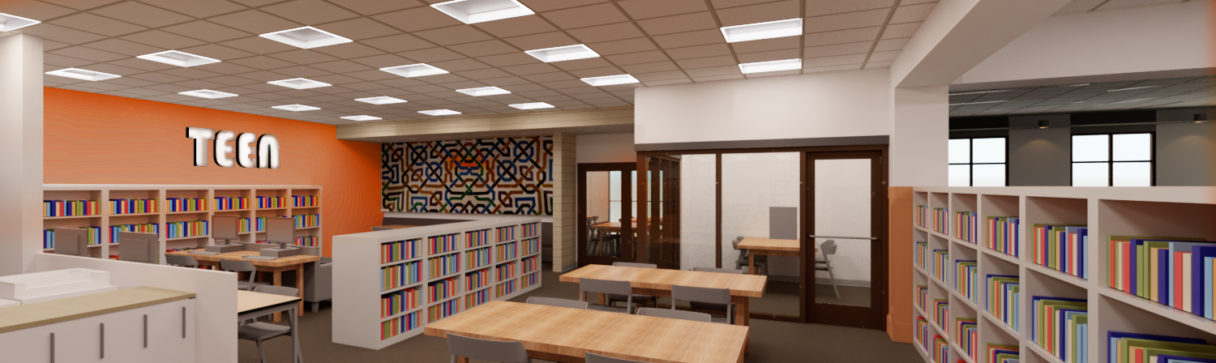

Slide 15
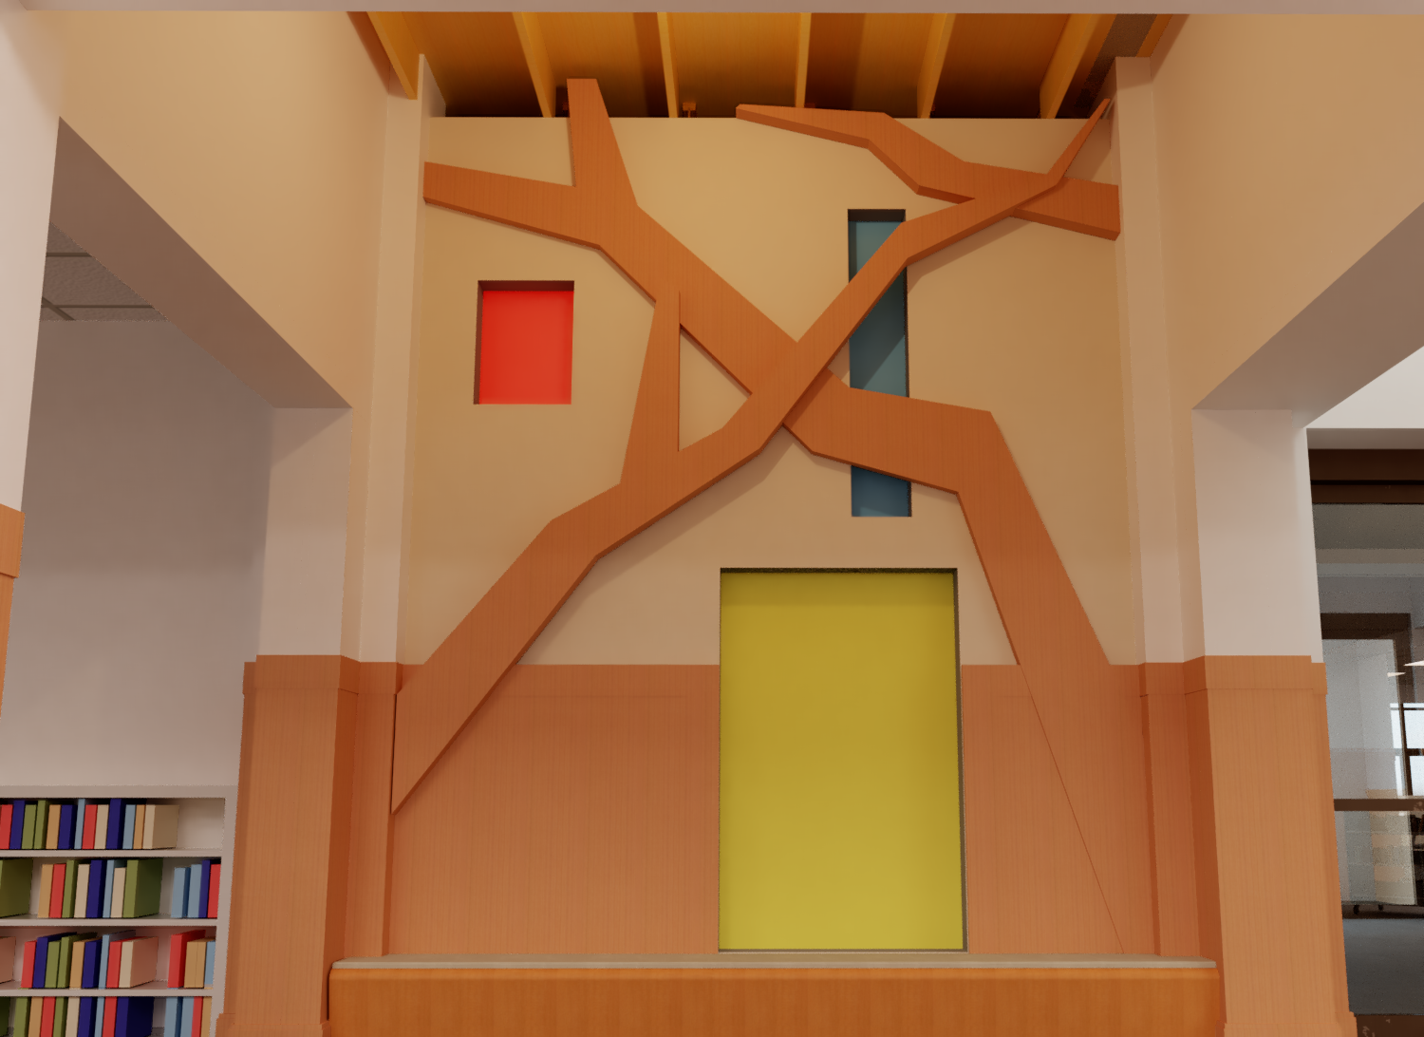

Slide 16
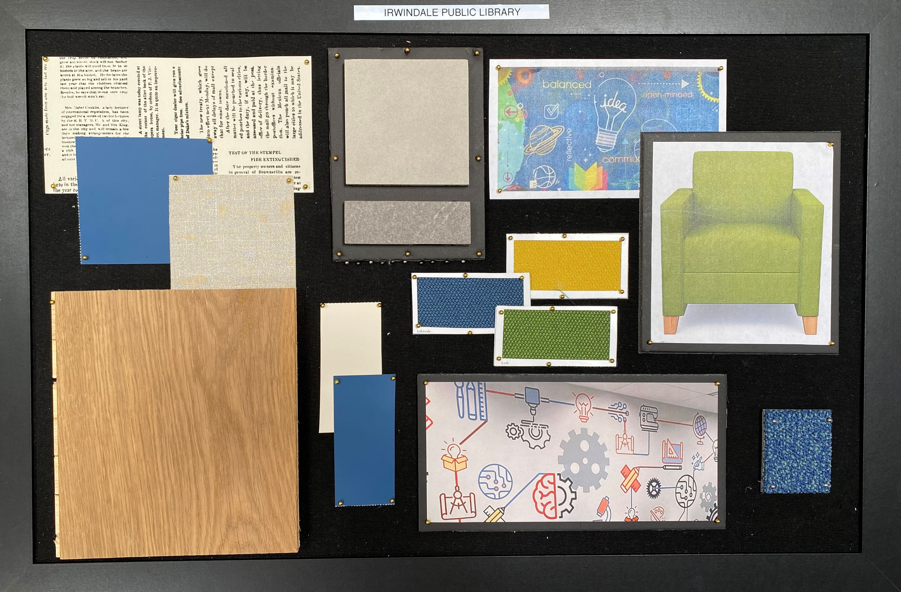
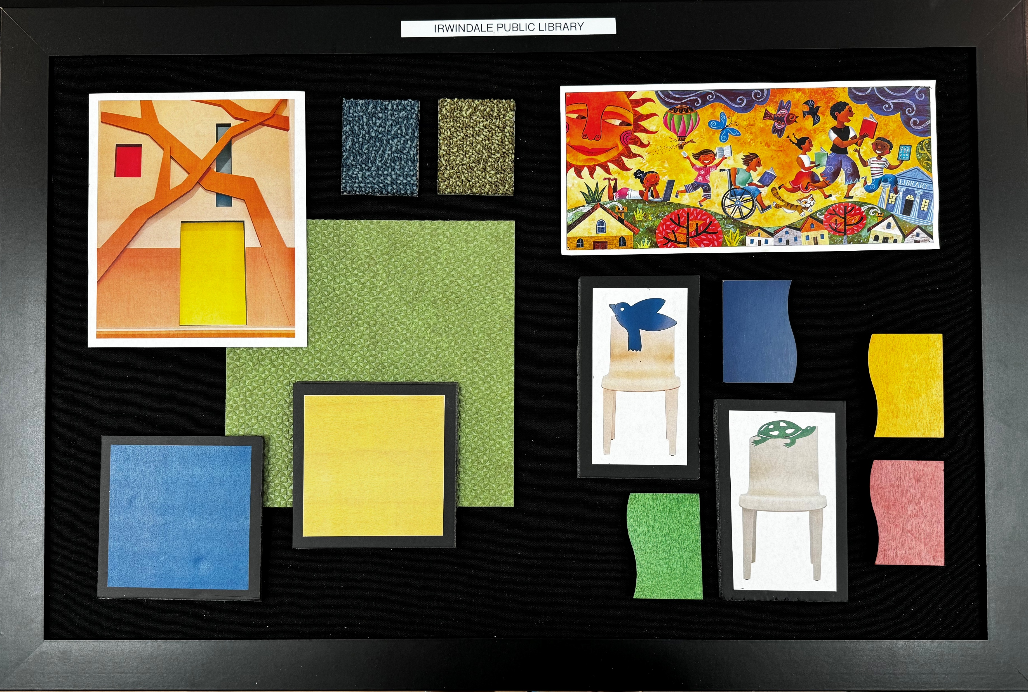
Color Schemes

Slide 17
Children’s Area Color Scheme

Slide 18
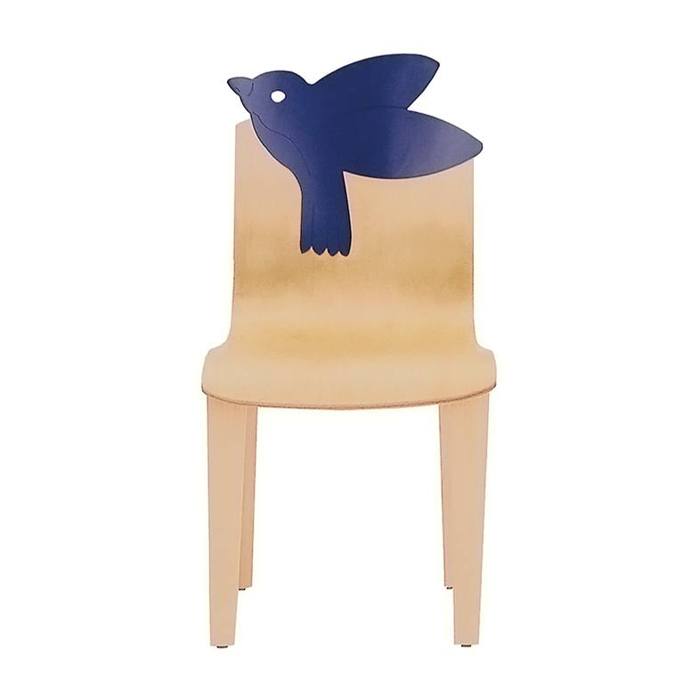


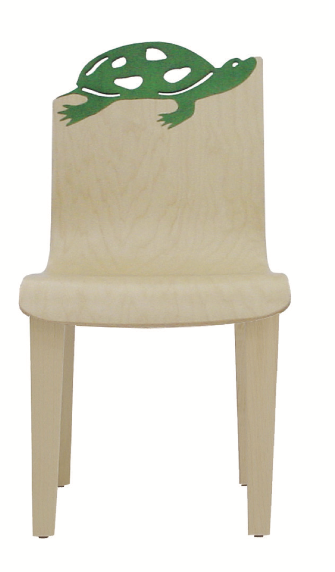


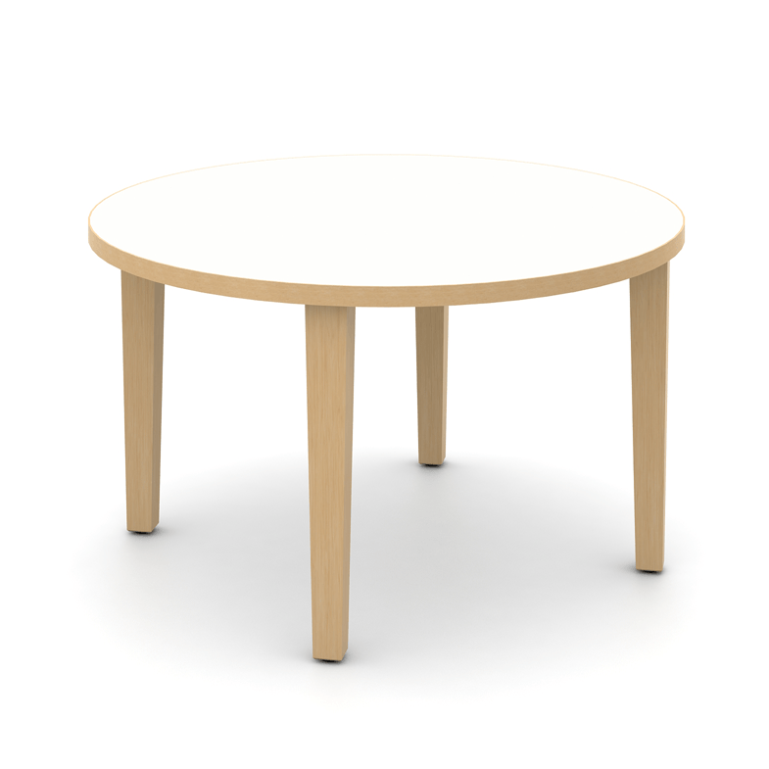
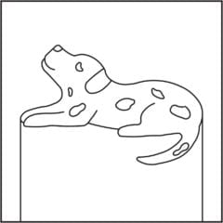

Children’s Space

Slide 19

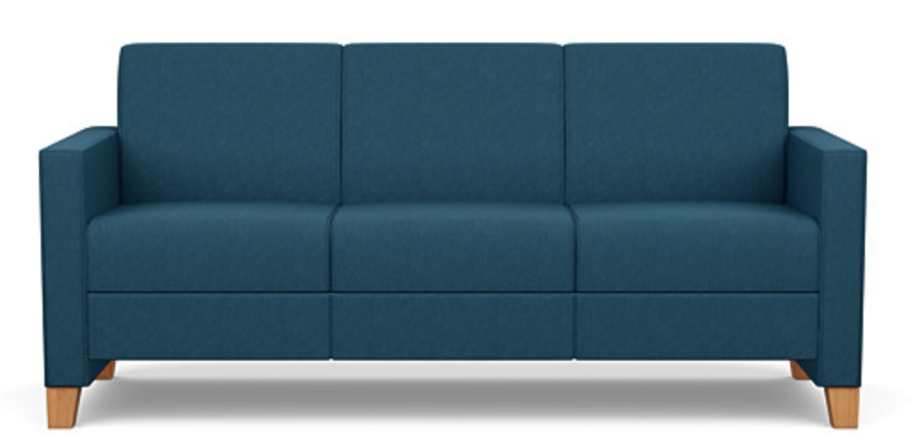

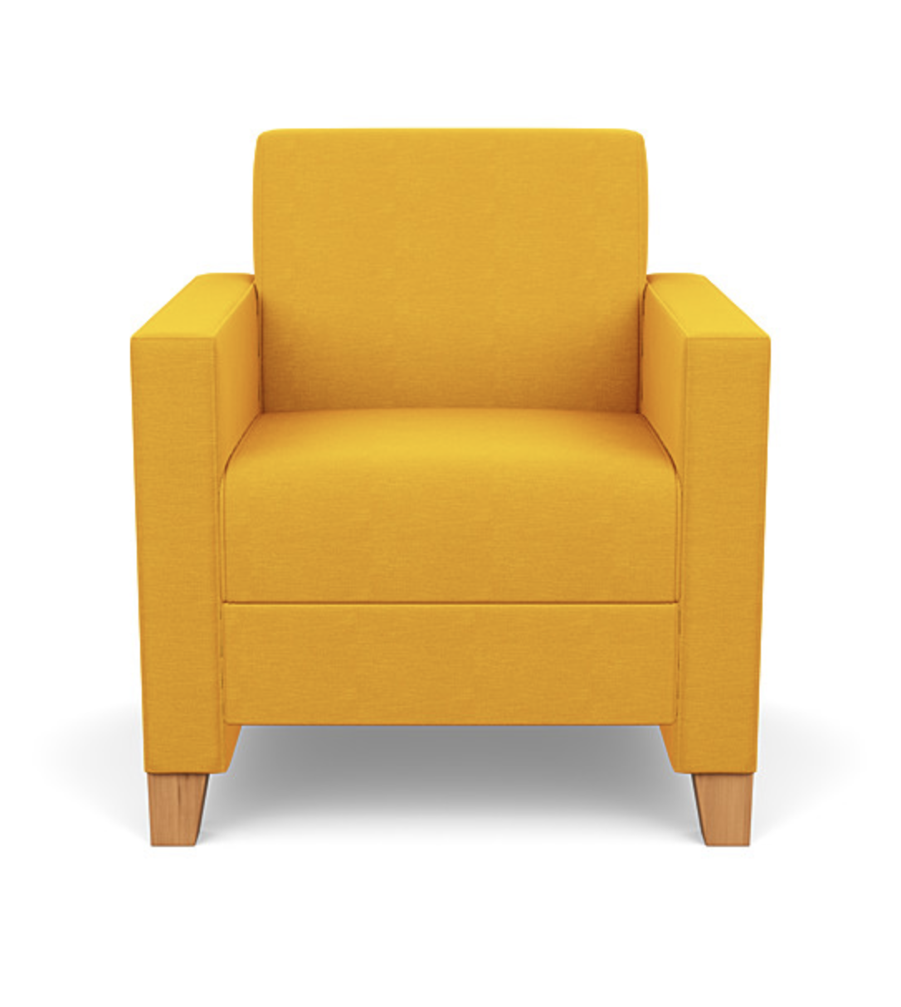
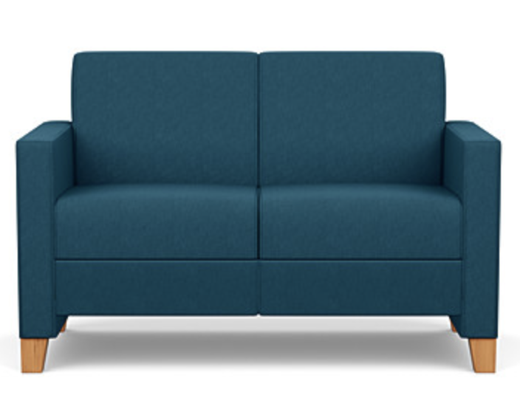
Family Place Furniture

Slide 20
Teen and Adult Color Schemes

Slide 21
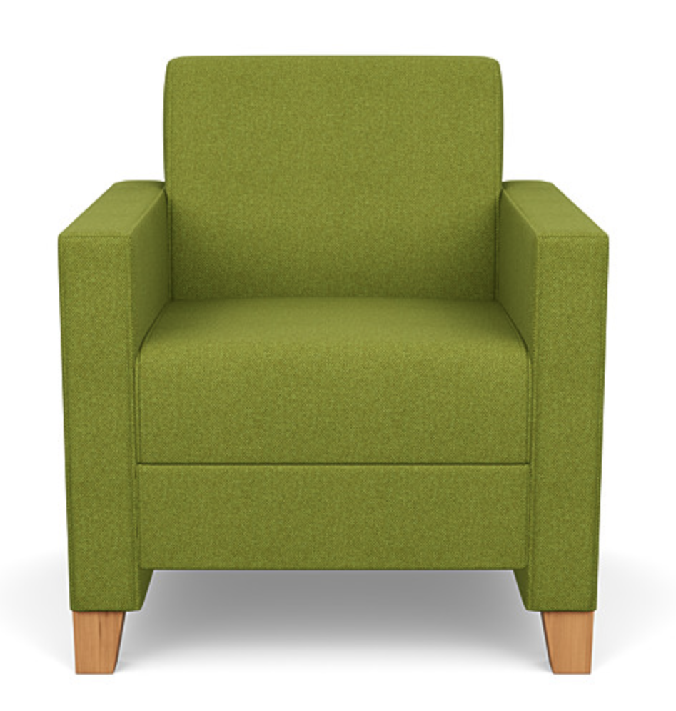

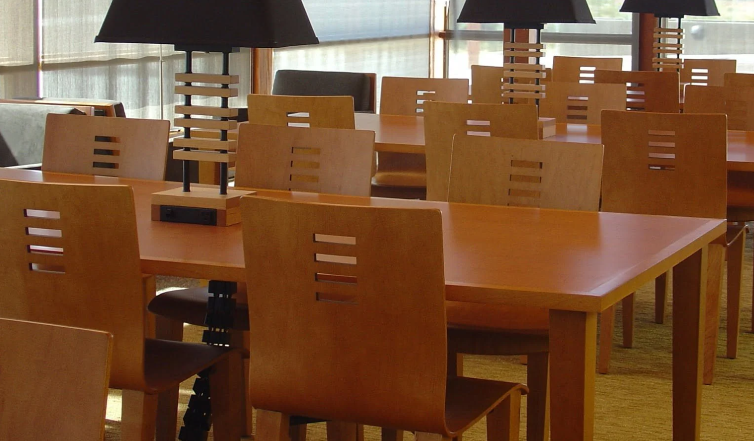
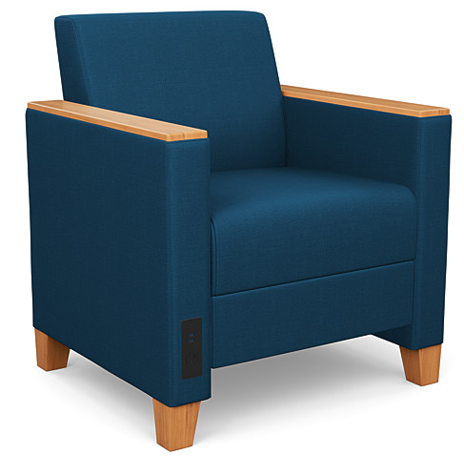
Adult and Teen Spaces

Slide 22
Next Steps
What’s Next?
Authorize staff to proceed with finalizing the plans that include color schemes, flooring and furnishing, along with specifications for this Project.
City's consultant will finalize the plans and specifications with the intent of having the City Council consider the final plans and specifications to release for bid on September 25, 2024.

Slide 23
Thank You

